Slide 1
Change Point Trace Plots
Ordinal vs. Continuous

Slide 2
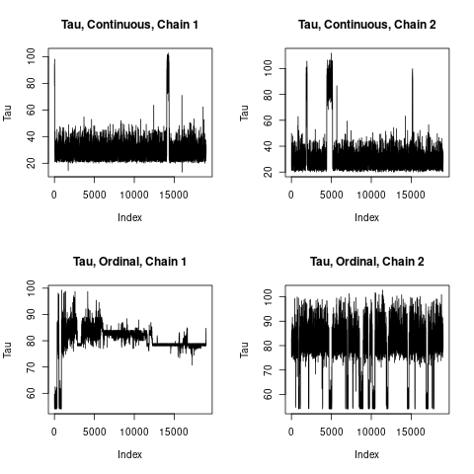
Erie County

Slide 3
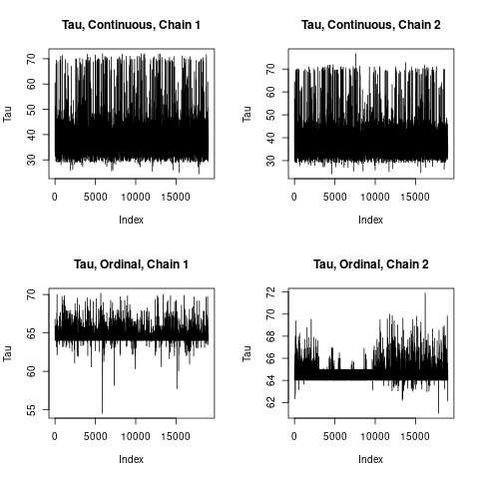
Essex County

Slide 4
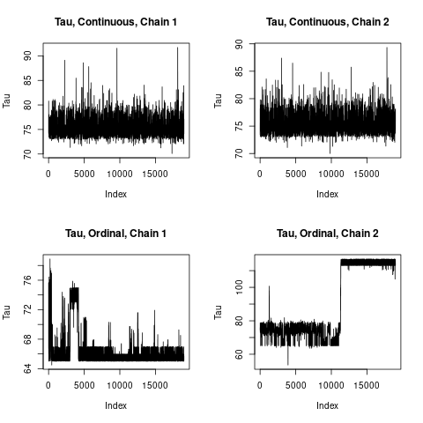
Herkimer County

Slide 5
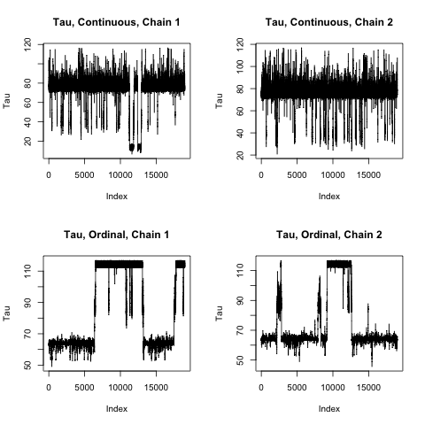
Jefferson County

Slide 6
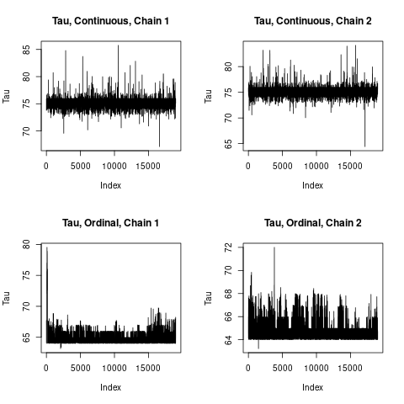
Madison County

Slide 7
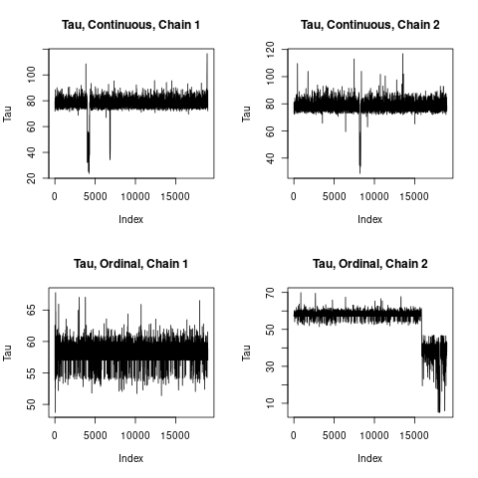
Oswego County

Slide 8
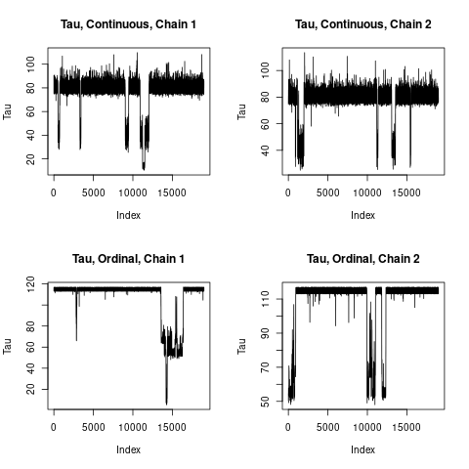
Steuben County

Slide 9
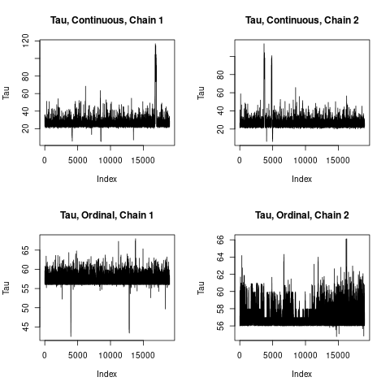
Westchester County

